Slide 1
The Great Controversy 4
The Waldenses
(Light Shines in Darkness)

Slide 2
Church History-Prophecy of 7 Churches
Ephesus
Smyrna
Pergamos
Thyatira
Sardis
Philadelphia
Laodicea
Early Church that left the first love
(see AA)
An era of spiritual darkness
(see GC, ch. 3,4)
The reformation that was not completed
(see GC, ch. 7-16)
The Church that delays Christ’s coming
The persecuted Church
(see GC, ch. 2)
The morning star in the midst of spiritual darkness
(see GC, ch. 5,6)
The true Advent Church
(see GC, ch. 17-41)

Slide 3
The Coat of Arms of the Waldenses
In the Waldensian Valleys the coat of arms with the words “lux lucet in tenebris” (light shines in the darkness) is encountered at every turn. It was first seen in 1640.
There is a candle and the seven stars from Revelations to refer to those congregations which have remained true to the Gospel since the time of the Apostles in spite of all persecutions.

Slide 4
In Every Age Witnesses for God
Their main doctrines
Christ as the only Mediator
The Bible the only rule of faith
Keeping of the Sabbath
On the British Islands (The Celtic Church)
Very soon it came to Britain (“They of Rome”)
Persecution spread it to Wales, Scotland and Ireland
Colomba (Iona 550)
Missionaries all over Europe (Root for Waldenses?)
Later Catholics conquered the land back
Central Africa (Coptics), Armenia, Albigenses?
Waldenses
Separation lead to a separate church from Rome
Rome’s hatred of Sabbath was one of the main causes of separation
The first to make a translation of the Bible into their language

Slide 5
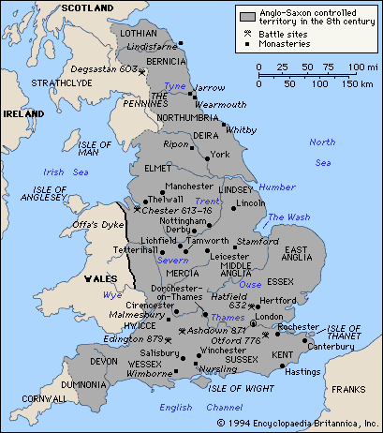
The Celtic Church
The Anglo-Saxon territory
The early Christian church (Celtic Church) in the British Isles was founded in the 2nd century. At that time the Britons lived here. Through heathen Roman persecution (Diocletian) they were driven further north, where they converted many druids (heathen).
In the 6th century the Saxons (Anglo-Saxons) invaded and occupied most of the country (see map). The Celtic Church soon was persecuted through intrigues by the Roman church. It survived in Wales until the 11th century and in Scotland and Ireland until the 12th.
Patrick brought the gospel to Ireland in the 5th century.
Columba founded missionary school in Iona (563) from where missionaries were sent out all over Europe.

Slide 6
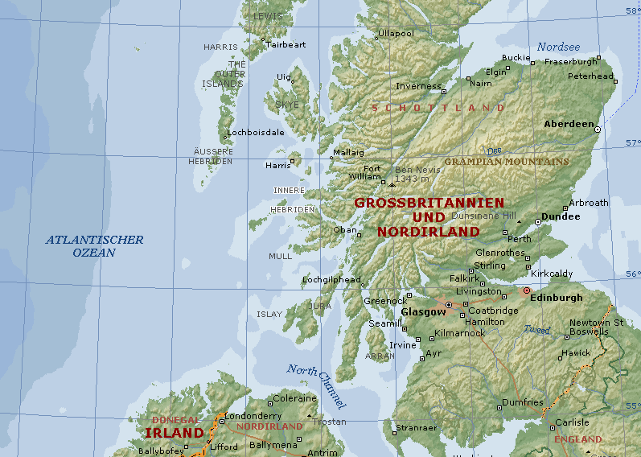
The Missionary Center of Iona

Slide 7
The Secret of the Strength of the Waldenses
The Education of their children
Drew comparisons between Bible truths and nature
Impressed with sacred claims of the law
Great portions of Scripture were committed to memory
To endure hardness, economy, self-denial
To submit to control
To think for themselves, forethought, faith
To bear responsibilities, personal labor
To guard their speech
The culture of intellect
The training of pastors
Before they fed the flock they went out as missionaries for 3 years
They did more than sermonize
Were sustained by freewill offerings and their own labor
They trained the youth
Bible the chief study especially gospels and epistles
They copied the Bible
The preservation of the Bible through them

Slide 8
The Mission of the Waldenses
They did not totally shun society
Contact with the world (merchants, peddlers)
Knowledge (sent youth to institutions)
The missionary spirit
They had to work under cover (right arm work)
Churches sprang up where they worked
Worked to counteract the deceptions of Rome
Taught the character of God
Had a personal effect: there was power in the word
They worked all over Europe
Persecution
The dragon got angry with them: illegal methods to persecute them
They continued to send out missionaries

Slide 9
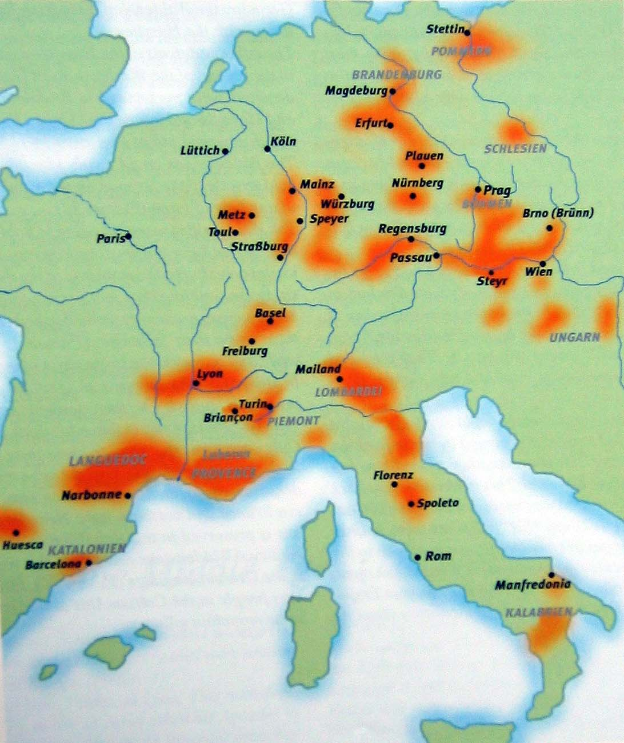
The Spreading of the Waldenses in Europe
The Expansion of the Waldensians in Europe between 1177-1532
During the Middle Ages the Waldensians constituted the most widespread “heretical” movement. From the 13th to the 15th century they were present in great parts of Western and Central Europe. At the beginning its centre was located south of the Alps, in southern France and in Lombardy but it soon moved further north.
The last persecution of Waldensians north of the Alps took place in Brandenburg in 1480. The survivors joined the Unity of Brethren in Bohemia and Moravia, a church which emerged out of Hussitism in 1458. South of the Alps the Waldensians were able to hold their own in the Cottian Alps, in Luberon and in Calabria.

Slide 10
Questions
What parallels do you see between the Waldenses and us today?
Shall we work under-cover?

