Slide 1
The Great Controversy 5
John Wycliffe
(The Morning Star of the Reformation)

Slide 2
Church History Prophecy of 7 Churches
Ephesus
Smyrna
Pergamos
Thyatira
Sardis
Philadelphia
Laodicea
Early Church that left the first love
(See AA)
An era of spiritual darkness
(See GC, Chapters 3,4)
The reformation that was not completed
(See GC, Chapters 7-16)
The Church that delays Christ’s coming
The persecuted Church
(See GC, Chapter 2)
The morning star in the midst of spiritual darkness
(See GC, Chapters 5,6)
The true Advent Church
(See GC, Chapters 17-41)

Slide 3
How the Lord Creates
New Life and Liberty
Interest in the Bible
  Availability of the Bible
In understandable language
In sufficient numbers
Providence
Life & Liberty
Understanding of the Bible
The Word of God is the source of life and liberty
among societies and individuals

Slide 4
Occasions for Reform
The pope’s claim of tribute from England
The work of the mendicant friars
  Discouraging honest work
  Claiming the power of forgiveness
  Ignorance
  Deceiving people, especially the youth
  Hypocrisy
  The general effect on the country
The perversity of church ecclesiastics
The schism of popes

Slide 5
Can These Be Reformed?
The lives of individuals
The order of mendicant friars
Society
The practice of simony
The understanding
of truth
Traditions that have no Biblical foundation
Yes
No
Reformation consists in
abolishing those things that cannot be reformed
and reforming other things that can be reformed.

Slide 6
Wycliffe’s Reforms
The pope has no authority over government.
The pope is not infallible (he is a sinner).
The Bible (not tradition) is the rule of faith.
The Holy Spirit can guide every ordinary person in understanding Scripture.
Every person can have direct access to God through Christ. No priest needed for that.
Pope and priests cannot forgive sins, only Christ can do that.
We are saved by grace not by works.
No priest can create God in the Eucharist.

Slide 7
The Work of John Wycliffe
Preaching the gospel in word and letter
The Translation of the Bible
Training workers (Lollards)
Exposed papacy
Liberated the people from papacy
A missionary center for Europe

Slide 8
Papacy
Authority of the Church
Authority of Government
Authority of the Bible
Authority of Conscience
The church (the pope and priests)
stands above the authority of the Bible.
The authority of government
stands above the authority of conscience.

Slide 9
Protestantism
Authority of the Bible
Authority of Conscience
Authority of the Church
Authority of Government
Protestantism places the authority of the Bible
above the authority of the visible church.
Also, it places the authority of conscience
over the authority of government.

Slide 10
Protestantism Defined
Concerning the protest of the princes at Speyers:
“The principles contained in this celebrated protest of the 19th April 1529, constitute the very essence of Protestantism. Now this protest opposes two abuses of man in matters of faith: the first is the intrusion of the civil magistrate, and the second the arbitrary authority of the Church. Instead of these abuses, Protestantism sets the power of conscience above the magistrate; and the authority of the Word of God above the visible church. In the first place, it rejects the civil power in divine things, and says with the prophets and apostles: We must obey God rather than man. In presence of the crown of Charles the Fifth, it uplifts the crown of Jesus Christ. But it goes farther: it lays down the principle, that all human teaching should be subordinate to the oracles of God.” (D’Aubigne, History of the Reformation, b. 13, ch. 6)

Slide 11
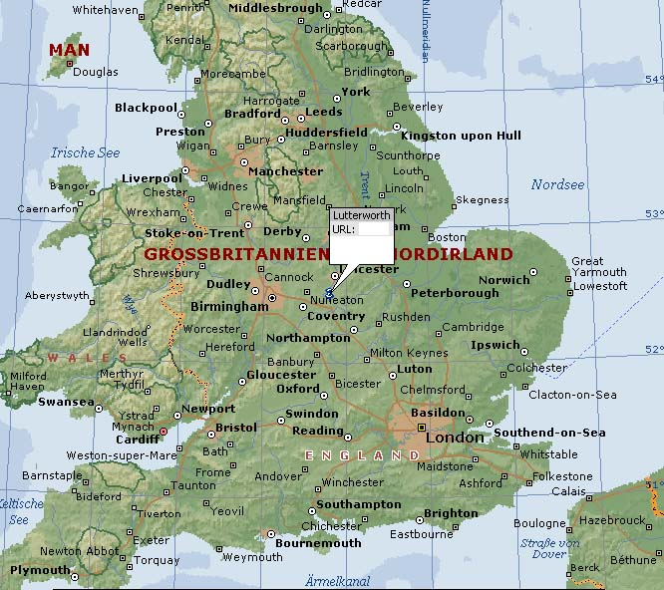
Wycliffe in Lutterworth

